Slide 1
LMDD：Light-weight Magnetic-based Door Detection with Your Smartphone
ICPP 2015, Beijing
Yiyang Zhao
Tsinghua University
Chen Qian
University of Kentucky
Liangyi Gong
Harbin Engineering University
Zhenhua Li Tsinghua University
Yunhao Liu
Tsinghua University
yiyangzhao@tsinghua.edu.cn
Sep. 4th, 2015
Notes:
Good afternoon. I will introduce our work LMDD, which is a light weight magnetic-based door detection method with smartphones. I am the first author, Yiyang Zhao, from Tsinghua university. Our work is a cooperative project of three universities.

Slide 2
Outline
1
Background & Motivation
2
Related Work
Methodology
3
Evaluation
4
5
Conclusion
Notes:
This is outline of my presentation.
First, let’s look at the background and motivation

Slide 3
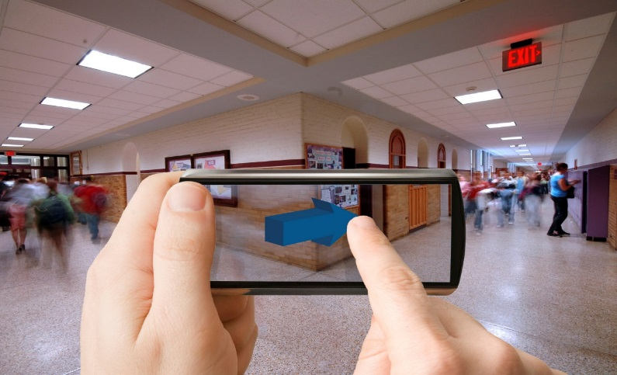
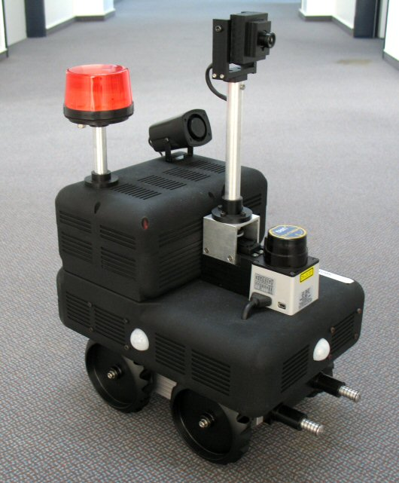
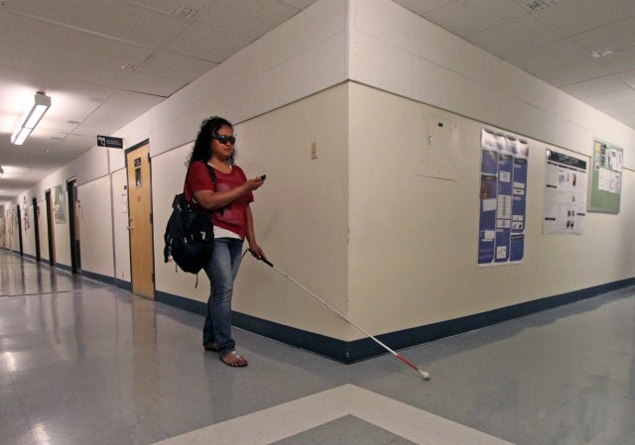
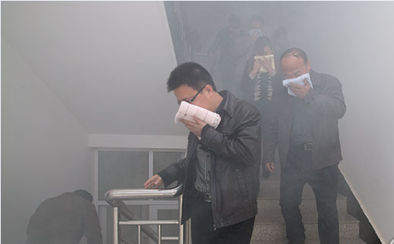
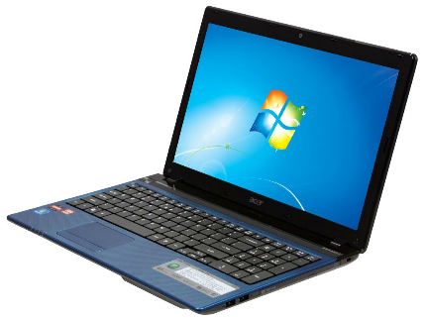
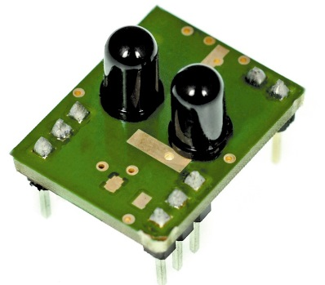
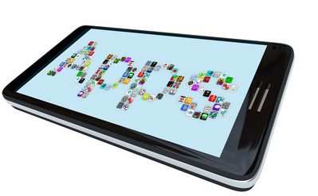
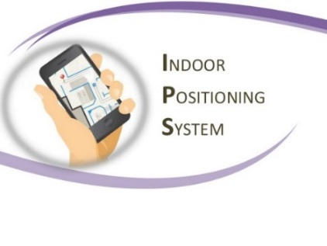
Indoor Positioning Services (IPSs)
Indoor location of people or equipment
Localization (where)
Navigation (how)
Intrusion detection (who)
Emergency evacuation
Fundamental function of many Location Based Systems (LBS)
Localization
Emergency
Special Devices
Robot
Smartphones
Navigation
Notes:
Indoor Positioning Services are widely used in many areas. The position information is very important for people, it can tell you where you are. Also it can navigate people to destinations or detect intrusions. In some emergency cases, IPS can give the right way for people. IPS is a fundamental function for many location based systems. According to devices providing IPS, there are two types. One is the special devices, for instance, the laptops or sensors. The other one is smartphones.

Slide 4
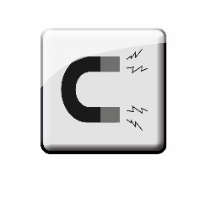
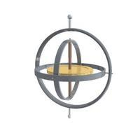
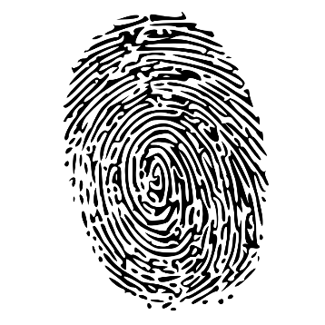
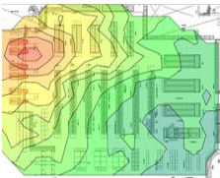
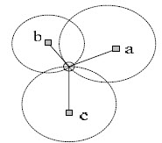
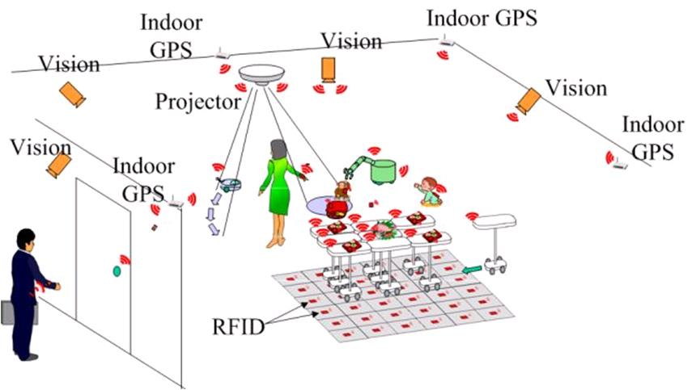
Indoor Localization based on Smartphones
Advantages of smartphones
Plenty of built-in sensors
Connectivity to the Internet
Computation ability
Approaches
Fingerprinting
Measurements
Notes:
Smartphones have following advantages. First, they contains plenty built-in sensors, such as magnetic sensor, gyroscope sensor, microphone, camera and compass, and so on.
The size of smartphones is appropriate. At the same time, they have the ability to connect to the internet through 3G or wifi and have computational ability.
Basic IPS approaches based on smartphones can be divided as two classifications: fingerprinting and measurements. In fingerprinting approaches, location is found by comparing features of wifi signals collected by smartphones with the wifi radio maps. In measurement approaches, distances between three anchors are determinated. The location is calculated by triangulation.

Slide 5
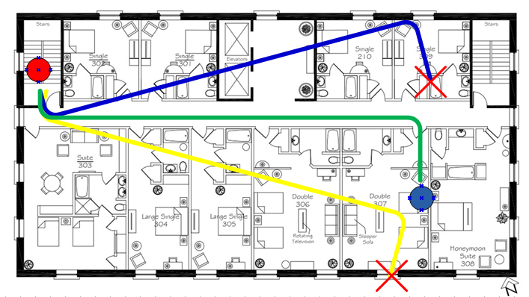
Open Issues
Error Accumulation
Costly Infrastructures
Complex Computation
A light-weight door detection method is highly desired!
Notes:
However, during the localization phase, there are few important open issues. First is the accumulation of errors, which is the fatal problem for most tracking or localization systems. As shown in this figure, people move from the start point, the red point, to the destination, the blue point. Perfect localization result will be the green line. Unfortunately, in most common cases, the localization results look like the blue or yellow lines. The basic reason is the inadequate anchor points, for example the red star. As the natural landmark, doors are obvious anchor points for localization systems.
The second problem is that Many preinstalled systems are required, which makes the cost of systems expensive. Like wifi\RFID\blue tooth and UWB.
More over, Site-survey is a time consuming and labor intensive work. It consumes lot computational resources.
Therefore, a light-weight door detection method is highly desired.

Slide 6
Main Observations
Magnetic Intensity → severe changes
Our goal is to find where the sharp fluctuations indicate “door events ”.
Human behaviors & environmental factors → magnetic signals
Notes:
Among sensing information of smartphones, the Magnetic signal is a kind of free resources.
During the experiments, we find that Magnetic Intensity has big changes when persons walk through doors
The reason is that modern buildings use lot of reinforced concretes. Meanwhile, doors contain metal components, like doorknob, doorframes.
In the same time, Human …also change magnetic signals.
Hence, our goal is..

Slide 7
Challenges
Collect magnetic signals accurately
Refine magnetic signal processing
Eliminate interruptions
Notes:
To accurately detect the sharp fluctuations in magnetic signals, we faced three challenges.
Frist one is how to Collect magnetic signals, which means that we need accurately measurements of magnetic intensities from various smartphones.
Refine … means we need to Exclude noises and fake changes.
The last one is to eliminate interruptions, like the slow changes.
I will say it is very difficult to estimate the changes caused by door events.

Slide 8
Outline
1
Background & Motivation
2
Related Work
Methodology
3
Evaluation
4
5
Conclusion
Notes:
Next, we will take look on some related work.

Slide 9
Three Types of Approaches
Vision Based
Infrastructure Based
Infrastructure-free Based
Notes:
Door detection has been a popular research topic in recent years. To our knowledge, related work of door detection can be roughly divided into three categories. Vision based , infrastructure based and infrastructure-free based

Slide 10
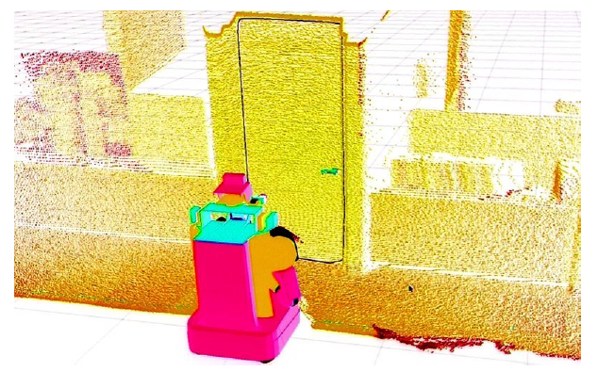
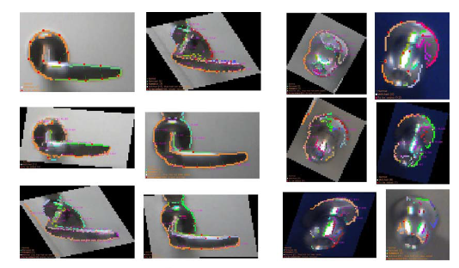
Pros and Cons of Vision Based Methods
Vision based
Intuitive
High computational cost
Failure in dark environment
Door frames
Door 3D models
Door handles & knobs
Notes:
Vision based approaches are intuitive. When you look for a door, the basic shape of that door is Criteria. Some researcher studied the door frames and found that each door has unique characteristic. As a another respect, 3d door model can be obtained by laser scanning. Door handles and doorknobs also provide hints to distinguish doors.
The drawbacks of vision based methods are the high computaitional cost, although they have good performance in the bright environment.
Specially, The vision based methods will fail in dark environment.

Slide 11
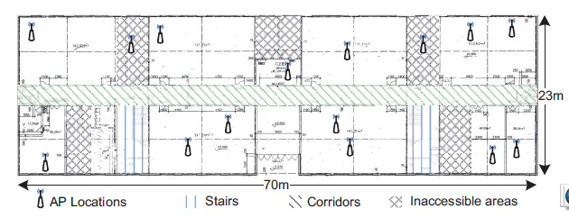
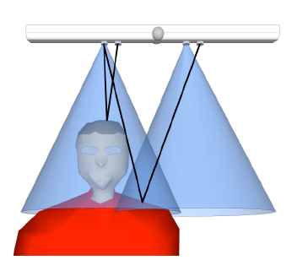
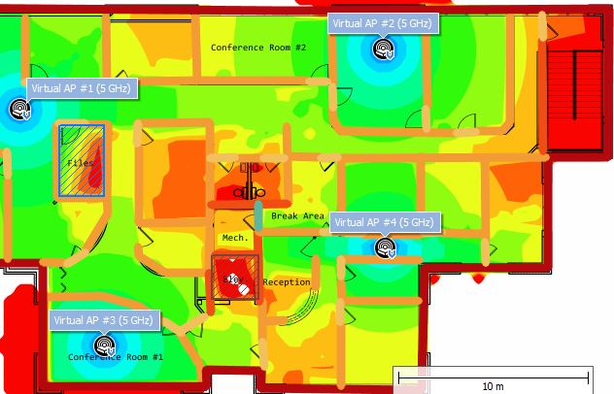
Pros and Cons of Infrastructure Based Methods
Infrastructure based
Sufficient information
Site-survey overhead
Expensive devices
Existing devices
Preinstalled devices
Site-survey
Notes:
The information for helping door detection is sufficient in infrastructure based methods. For example, the existing wifi Aps can provide enough RSSI information. From preinstalled ultrosound sensors, the moving objects can be detected when they cross a door.
But, as mentioned before, Pitfalls of those methods are obvious, such as heavy site-survey overhead and expensive deployment of devices.

Slide 12
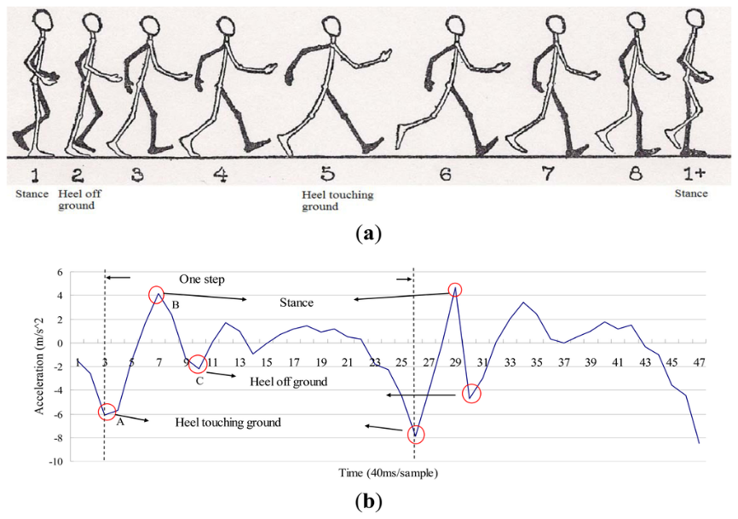
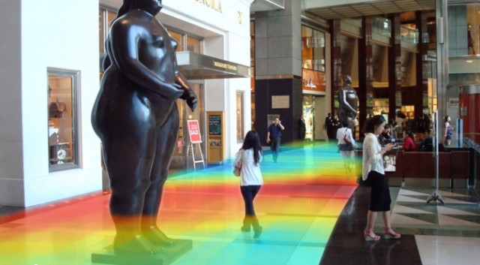
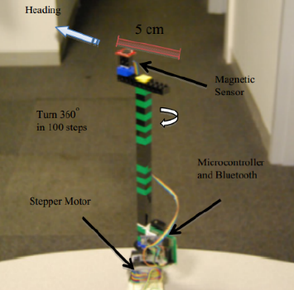
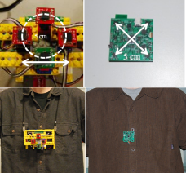
Pros and Cons of Infrastructure-free Based Methods
Infrastructure-free based
Free resources
Low precision
Inertial sensors
Magnetic sensors
Smartphones
Notes:
Infrastructure free based approaches use free resources, such as the readings from inertial sensors, magnetic sensors and smartphones. They Don’t require any preinstalled equiptments, Only use built-in sensors. The weakness is that the precision of those methods is low.

Slide 13
Outline
1
Background & Motivation
2
Related Work
Methodology
3
Evaluation
4
5
Conclusion
Notes:
I will introduce our method in detail.

Slide 14
Procedures of LMDD
Short and Shape
Notes:
This is main procedures of LMDD. There are five steps to detect a door. When raw magnetic signals are collected from smartphones, in the pre-processing phase, the modified edge preserving filter is applied to wipe out the Gaussian white noise from raw data. In the Denoising step, other
noises generated from environmental signals are wiped. In the Feature Definition step, we use a Bayes function based on empirical feature classifications to regenerate the signal. After above steps, the door events can be detected.

Slide 15
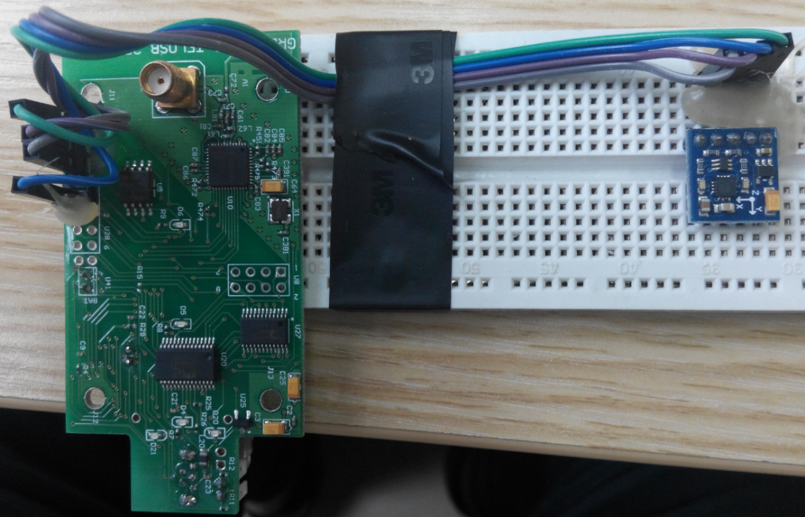
Calibration Magnetic Sensors of Phones
High-precision magnetic sensor-----Honeywell HMC5883L
Linear compensation of errors
Sampling rate is 50 Hz
Notes:
Since the built-in magnetic sensors of smartphones are different, we calibrate those phones before experiments. Honeywell 3-axis sensor has high-precision, which is around milligauss level.
We bind the smartphones and the sensor together. Linear compensation of errors is applied for different smartphones.
The sampling rate of those smartphones is 50HZ.

Slide 16
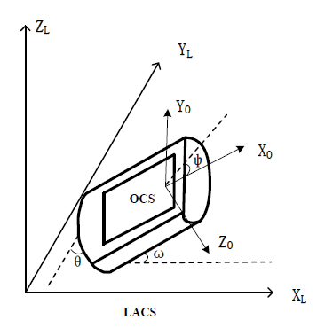
Attitude of The Smartphone
Different carrying ways
Hold in hand
Put in pocket
Lie in bag
Normalization of magnetic signals
OCS to LACS
Three angles
Azimuth angle ψ
Pitch angle ω
Roll angle θ
Notes:
There are many ways to take a cellphone, like holding in a hand, putting into pocket or lying down in the bag. So that, the magnetic strength should be normalized before signal processing.
We defined two coordinate systems, OCS means onboard coordinate system and LACS means the local absolute coordinate system.
To transform signals between those two systems, three angles are introduced. The azimuth angle is the polar angle. The pitch angle controls the relative angle with horizontal plane. And the roll angle refers the rotation angle around axis Xl.
The magnetic intensity can be calculated as this formula.

Slide 17
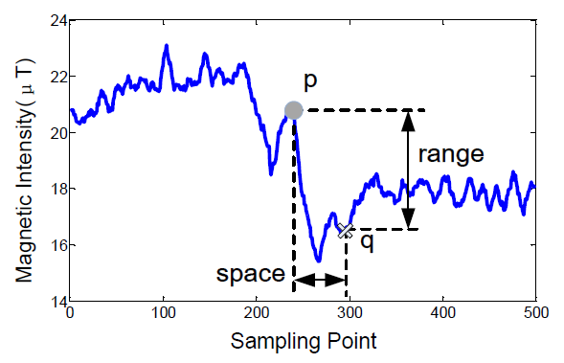
Signal Processing
Pre-processing
Clear periodic noises
Edge preserving filter
Remove slow changes
Keep sharp changes
Gaussian kernel
Space kernel
Range kernal
Notes:
During the signal processing phase, two steps are required.
In pre-processing, the periodic noises and Gaussian (声高金） noises are wiped.
After that, we apply a new edge preserving filter to remove those slow changes and keep sharp changes.
Two Gaussian kernels are obtained based on the analysis of empirical results. Sita s and Sita r are adjustable constants, which decide the range features in the time domain and magnetic difference in the intensity domain.

Slide 18
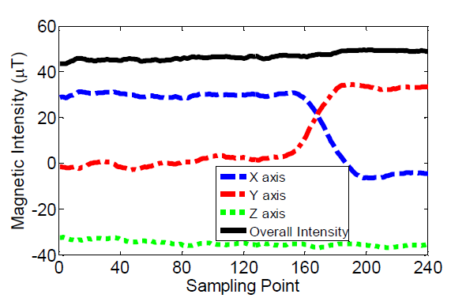
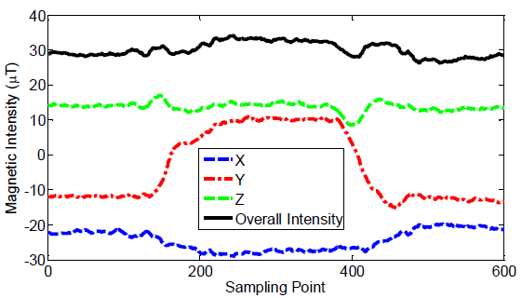
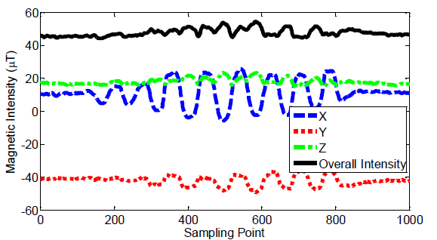
Feature Correlation
Detailed signal features
Turning around
Closing metals
Shaking body
Cross correlative function
Notes:
When we study the magnetic signal features, we Not only consider the overall magnetic intensities, but also investigate detailed signal features.
For example, when people turn aronud, the average magnetic intensity almost keeps in the same value, but the values of x-axis and y-axis seem “exchanged”.
If the smartphone holder moves to a metal object, the pattern likes this figure.
When the man carrying a smartphone walks slowly and shake body, the patterns like this waves for x and y axis.
We use cross correlative function to search those positive activities.

Slide 19
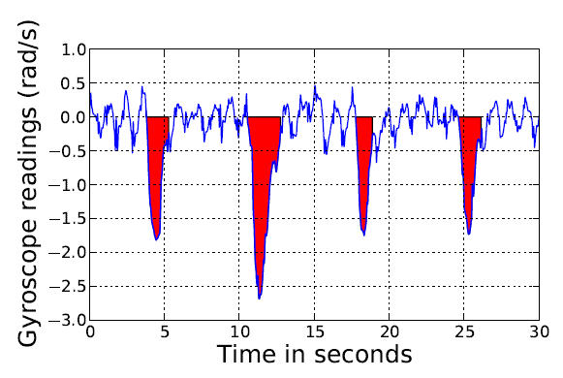
An Extra Built-in Sensor
Gyroscope sensor
Activity ≥ 90°→ Query window (±2s)
Notes:
We also borrow information from other sensors of smartphone, for example, the gyroscope sensor.
It can record rotations of the smartphone. Like the red parts of this figure, the angle of rotation depends on the area of the red part.
We find that crossing a door often is related with the activity which causes the rotation angle bigger than 90 degree. If the gyroscope sensor reports an activity, we will use a query window, whose time period is plus-minus two seconds, to analyse magnetic signals.

Slide 20
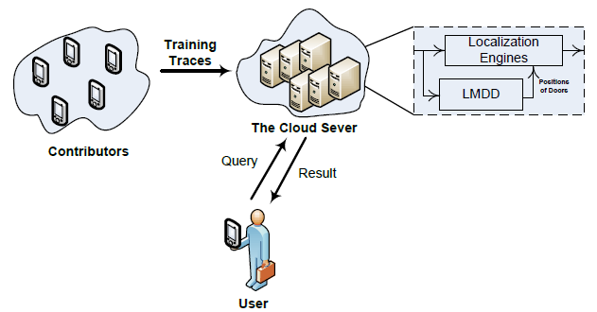
Crowdsensing Architecture
Database
Historical traces
Correlation
Compare query with database
Middleware
Report position of doors
Notes:
Single smartphone may detect some doors in buildings. However, there are lot missing and false negatives. So that, we design a crowdsensing architecture to reduce the false negative rate of event detection.
During the crowd sensing period, locations of doors can be recovered by dead-reckoning methods.
The typical process of crowd sensing is shown in this figure.
Contributors collect sensing data from built-in sensors of their smartphones during the training phase and stored in database of the cloud server.
Users send query to the server and get results from it.
Our LMDD serves as a middleware to other localization engines.

Slide 21
Outline
1
Background & Motivation
2
Related Work
Methodology
3
Evaluation
4
5
Conclusion
Notes:
Next, we evaluate our method in real experiments.

Slide 22
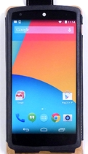
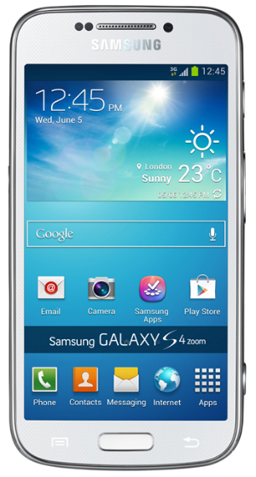
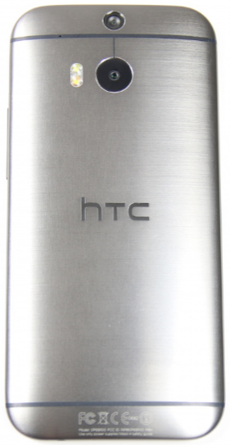
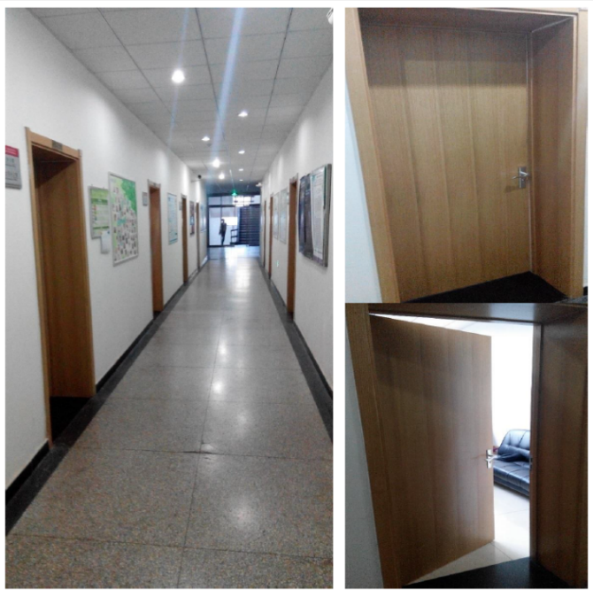
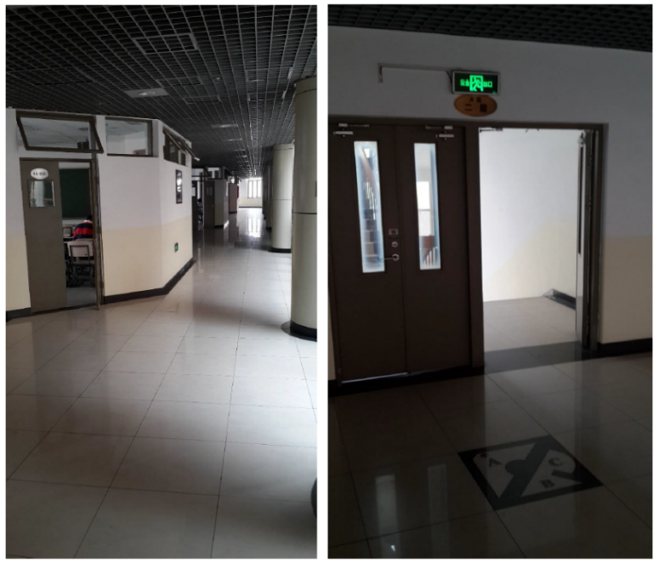
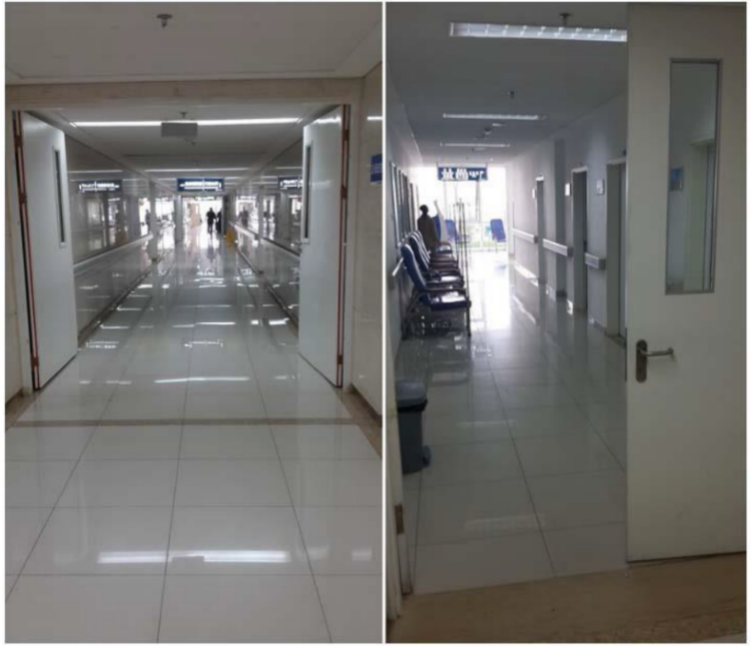
Experimental Settings
Android phones
Typical environments
Google
Samsung
HTC
Notes:
We use multiple popular Android phones, including Google Nexus5, Sumsang Galaxy S4, HTC One M8, Huawei ,xiaomi and so on.
50 volunteers conducted experiments in three months and collected more than 1800 traces.
Four typical environments, including offices, classrooms, residential houses, and a hospital, are explored. Pictures show the doors and corridors of office, class room and the hospital.

Slide 23
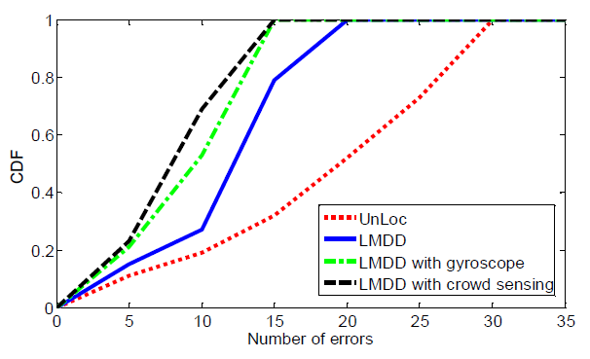
Experimental Results
Three rates
TP, FP and FN
Comparison result
Unloc, LMDD, LMDD+sensor and LMDD+crowdsensing
Notes:
To evaluate the performance of our method, we use three types of prediction rates: true positive (TP), false positive (FP) and false negative (FN).
The accuracy is about 74% in average, ranging from 66% to 85%.
We compare our work with Unloc, from the results, we can see LMDD has advantages to unloc. If information obtained from gyroscope sensor and crowdsensing scheme are added. The performance will get better.

Slide 24
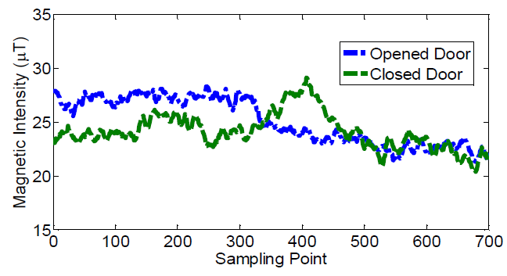
Experimental Results (Cont.)
Impact of door types
Metallic, Wooden, Glass
Performance of door status
Opened and closed
Notes:
We also consider two influence factors, including door types and door status. From results, we can see metallic doors are easily to detect than wooden and glass doors.
Door status also impact the traces. For closed door situation, a noise is introduced.

Slide 25
Lessons from Implementation
Simple & straight
Magnetic single processing
Few difficulties during the real deployment
Precisions of various smartphones
Calibration & adjustment
Fusion of multiple traces
Common anchor points & step counts
Distinguishing of different doors
Features & other indicates
Notes:
Although our work looks like simple and straight-forword, Acturally , In real-world experiments we learn some lessons, that I want share with you.
The precisions and sampling rates are quite different for various smartphones. Only dependiens on calibration methods is not enough, we need adjust phones one by one.
For comparing different traces from contributors, we employ common anchor points, such as elevator and strairs. If inertial sensors are used, step counts will be another parameter to help the fusion.
To distinguish doors, magnetic features near doors are used. Other indicates, like metal furnitures and doorknobs, will emerge unique features of different doors.

Slide 26
Outline
1
Background & Motivation
2
Related Work
Methodology
3
Evaluation
4
5
Conclusion
Notes:
Finally, we reach the conclusion.

Slide 27
Conclusion
We proposed a magnetic based light-weight door detection approach – LMDD. It is light-weight in both computation and infrastructure cost.
3
Magnetic signal edge-preserve filter
Built-in sensor fusion scheme
Crowdsensing framework
LMDD shortcomings:
More sensors, starting points of traces.
Notes:
As summary, we…
There are 3 main parts of our contributions, the first one is…. Second is , last is
However, LMDD still has lot of shortcomings, for example, how to use other sensors. How to find the starting points of traces.

Slide 28
Thank you for your attention
Questions?

Slide 29
Press ESC to exit …

Slide 30
Transformation Matrix
Notes:
When we

